Slide 1



Chatbot Evaluation System Report
This report provides a comprehensive evaluation of a book recommendation chatbot system, assessing its performance across various metrics. The system utilizes state-of-the-art tools including LangChain, HuggingFace embeddings, Pinecone, and OpenAI's GPT-3.5. The evaluation focuses on retrieval metrics, generation metrics, and latency to provide a holistic view of the chatbot's capabilities and areas for improvement.
sb
by shima bolboli

Slide 2

√
Retrieval Metrics
1
Context Precision
2
Context Recall
3
Context Relevance
4
Context Entity Recall
5
Noise Robustness

Slide 3
√
Generation Metrics
1
Faithfulness
2
Answer Relevance
3
Information Integration
4
Counterfactual Robustness
5
Negative Rejection

Slide 4

Latency
Response Time Measurement
Measures the average response time of the system from receiving a query to delivering an answer.
Performance Optimization
Focuses on improving model efficiency and reducing processing time to enhance user experience.
Resource Allocation
Implements adjustments to optimize resource usage and minimize latency in the chatbot system.

Slide 5





Methodology
Data Collection
Gather user queries, true labels, and system responses for evaluation.
Embedding Generation
Create embeddings for queries, true labels, and generated responses using advanced transformer models.
Metric Calculation
Apply various algorithms to compute precision, recall, relevance, and other performance metrics.
Analysis
Interpret results and identify areas for improvement in the chatbot system.

Slide 6




Proposed Improvements
Upgrade Model
Change embedding model to 'sentence-transformers/all-MiniLM-L6-v2' for improved performance.
Enhance Embeddings
Incorporate context-specific information into embeddings to better capture text nuances.
Optimize Chunking
Implement proper chunk size and overlap for improved text embedding in the database.

Slide 7
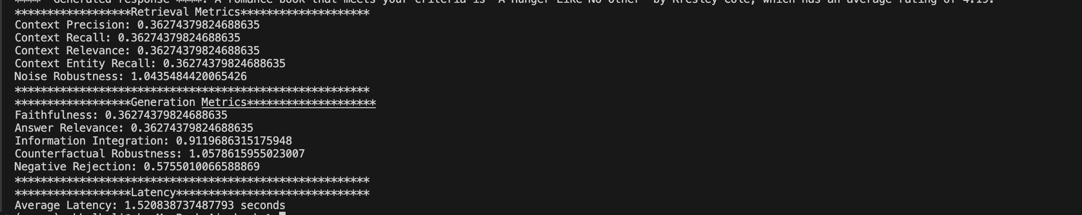
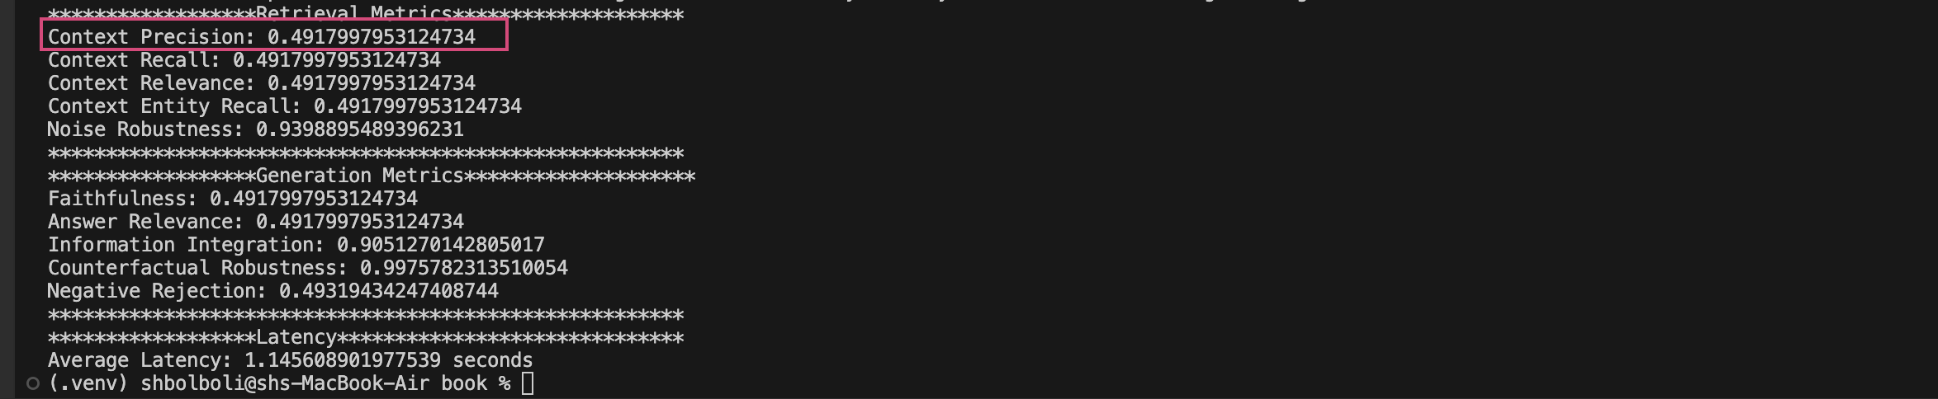
Improvements Implementation
Before
After

Slide 8
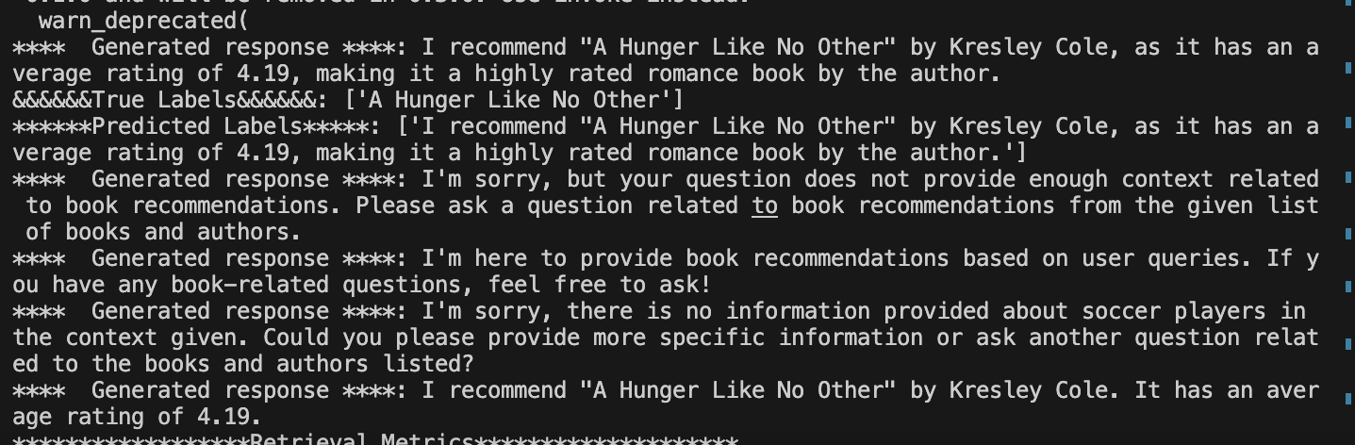
Sample of Generated Answer

Slide 9

Challenges and Solutions
Challenge
Solution
Handling Large Contexts
Implement context chunking and trimming techniques
Noise and Irrelevant Queries
Add pre-processing steps and noise detection algorithms
Latency Issues
Optimize response generation and resource allocation

Slide 10

Conclusion and Future Work
1
Performance Improvements
The proposed enhancements have shown significant improvements in Context Precision and other metrics.
2
Ongoing Challenges
Continued work is needed to address latency issues and further improve robustness against noise and irrelevant queries.
3
Future Directions
Explore advanced language models and novel embedding techniques to push the boundaries of chatbot performance.

